Slide 1
Exporting Geospatial Expertise
Python Scripting for ArcGIS
Patrick Flanigan
09/17/2015
Notes:
Purpose: To package and export expertise, enabling the creation of geospatial products that a user would not otherwise have the knowledge or time to create.
Focus: This presentation focuses the creation of range ring maps through a series of graphical user interfaces

Slide 2
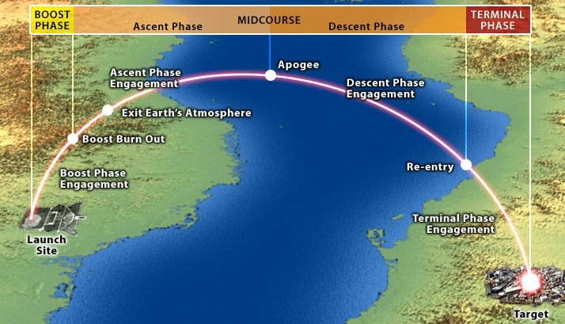
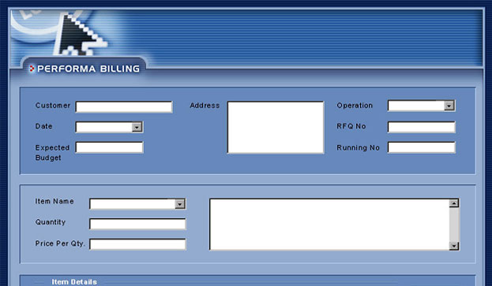
https://bmd.ncia.nato.int/PublishingImages/des_images/trajectory.jpg
Notes:
My name is Patrick and I work for the Missile Defense Agency’s Intelligence Requirements Division.
Our division’s goal is to act a conduit between MDA and the intelligence community (IC) facilitating the understanding of the current threat environment and visualizing future threats trends and its challenges in support of the ballistic missile defense system.
Our division’s mission is to provide intelligence requirements support to senior leadership satisfying needs for understanding and visualizing the current and future strategic environment and its challenges to support future military strategic planning activities.
However…

Slide 3

Notes:
The threat is in a state of constant evolution; in both scope and severity and in doing so opens new opportunities to support our government client.

Slide 4

What if we could hire someone to create geospatial products?
Notes:
I overheard a conversation from my boss and another government coworker regarding the generation of geospatial products for the Missile Defense agency.
He wanted to bring on a low level person to create range ring maps for the agency.

Slide 5

Contractors are expensive I don’t want to spend anymore money!
Notes:
However, there is nothing short of invigorated rage when it came to the associated costs of keeping let alone of bringing on additional contractors.
Thus a question presents itself.
How can you bring on the required expertise if the client is not willing to appropriate the additional funds?

Slide 6



A programmer
An analyst
A process
Notes:
My solution is to bring experience from a programmer, an in house analyst and the process that creates the geospatial product.
Since late last year I have been learning how to program in python to integrate map making processes along with my expertise in missile defense and geospatial intelligence.

Slide 7
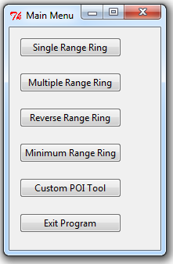
Range Ring Generator Tools
--Product: Single range ring around a country’s border
--Product: Multiple range rings around a country’s border
--Product: Shaded region of country where a system has to reside in order to reach a point target (i.e. major city)
--Product: Single range ring representing minimum distance between a shooter and a target country.
--Product: Single or Multiple range rings with a minimum and maximum range for a place and associated weapon system.

Slide 8
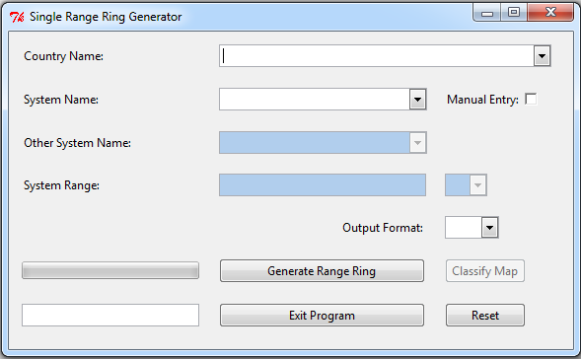
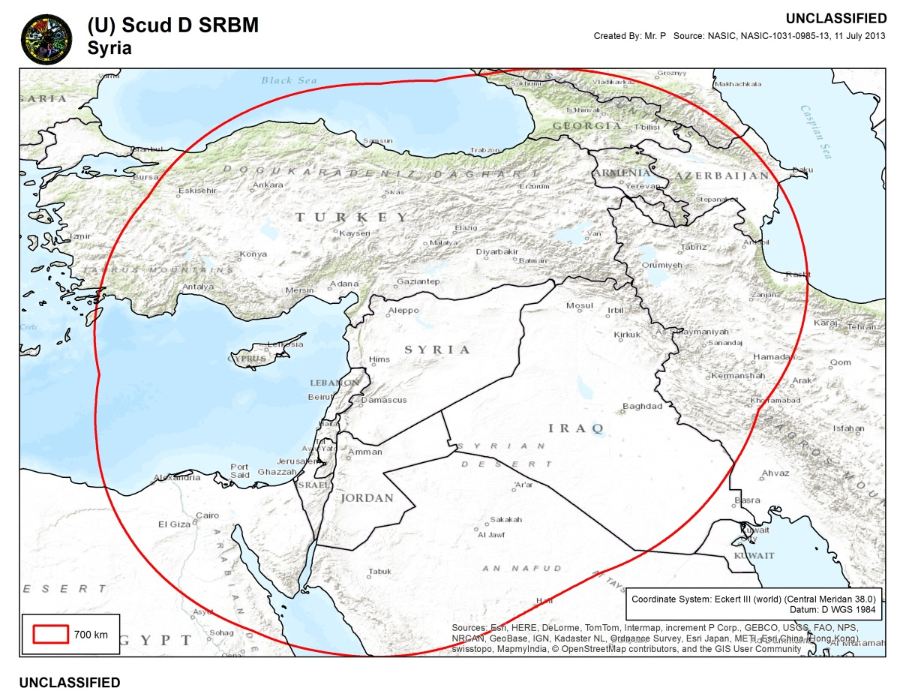
Single Range Ring Tool
Example of Single Range Ring Output from the country border of Syria
Missile Type: Scud D SRBM (range 700 km)
Time: 25 seconds
(Alienware M11x Intel i7 CPU (quad core) U640 @ 1.20 GHz 4.00 GB RAM)
Notes:
Time of execution!
Matrix of processing time

Slide 9
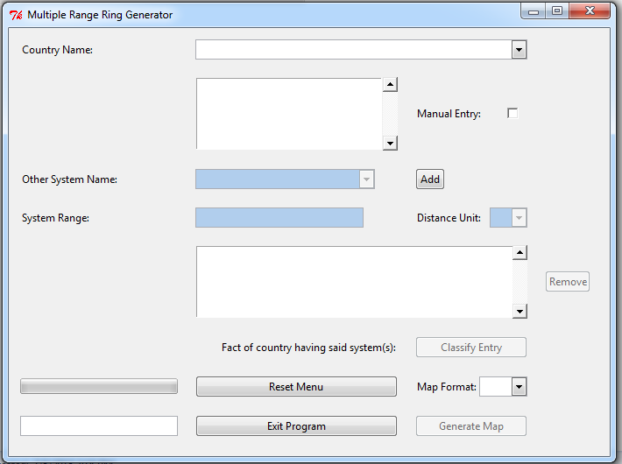
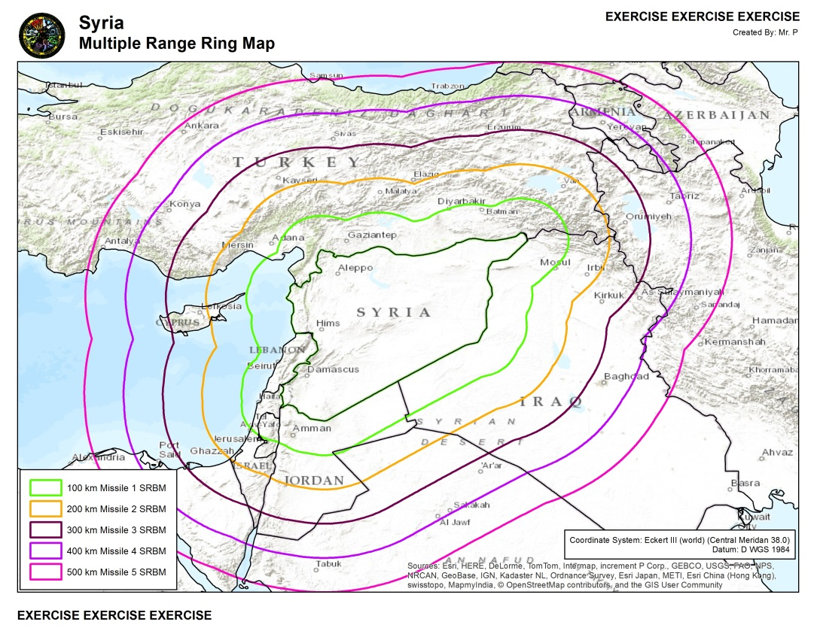
Multiple Range Ring Tool
Example of Multiple Range Ring Output from the country boundary of Syria
Missile Type: SRBM (ranges from 100-500 km)
Time: 1 minutes 28 seconds
(Alienware M11x Intel i7 CPU (quad core) U640 @ 1.20 GHz 4.00 GB RAM)

Slide 10
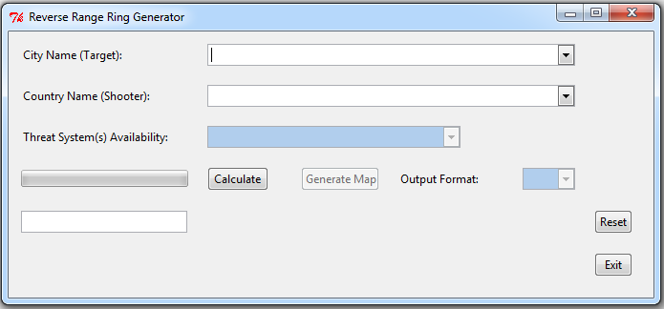
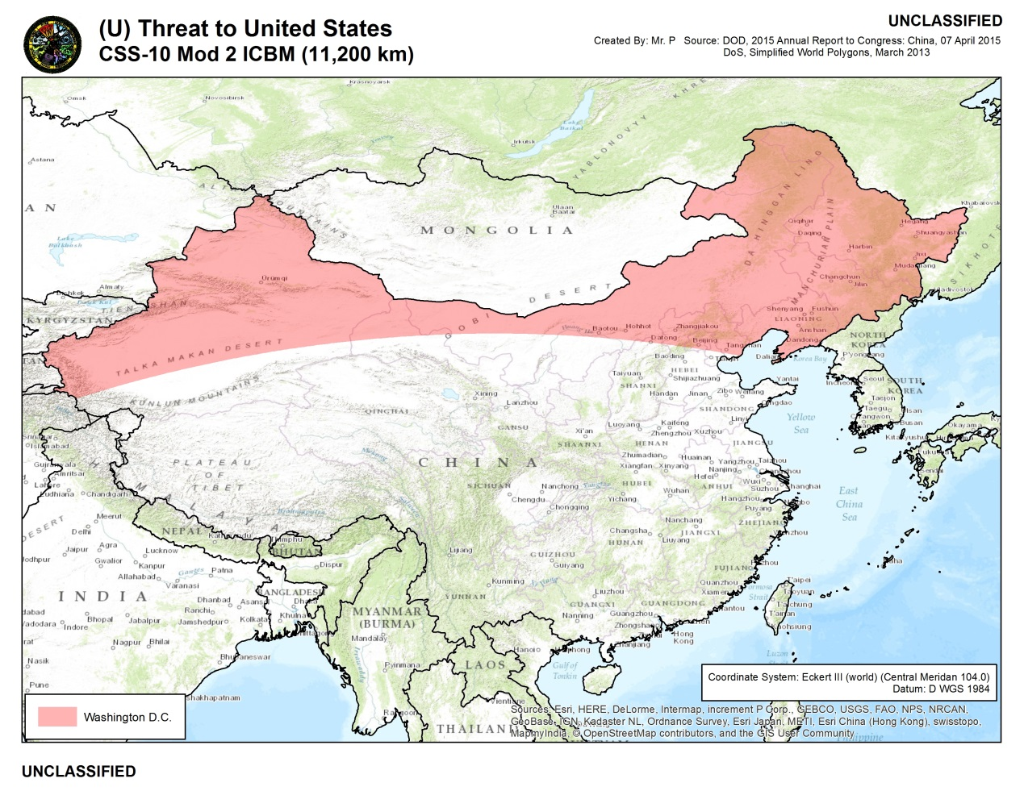
Reverse Range Ring Tool
Example of Reverse Range Ring Output
Missile Type: CSS-10 Mod 2 ICBM (11,200 km)
Calculate: 1 second
Generate Map: 15 seconds
Total: 16 seconds
(Alienware M11x Intel i7 CPU (quad core) U640 @ 1.20 GHz 4.00 GB RAM)

Slide 11
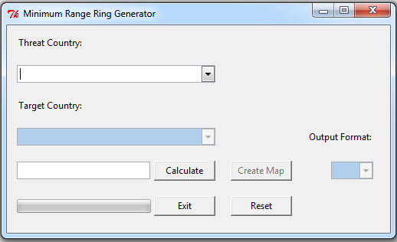
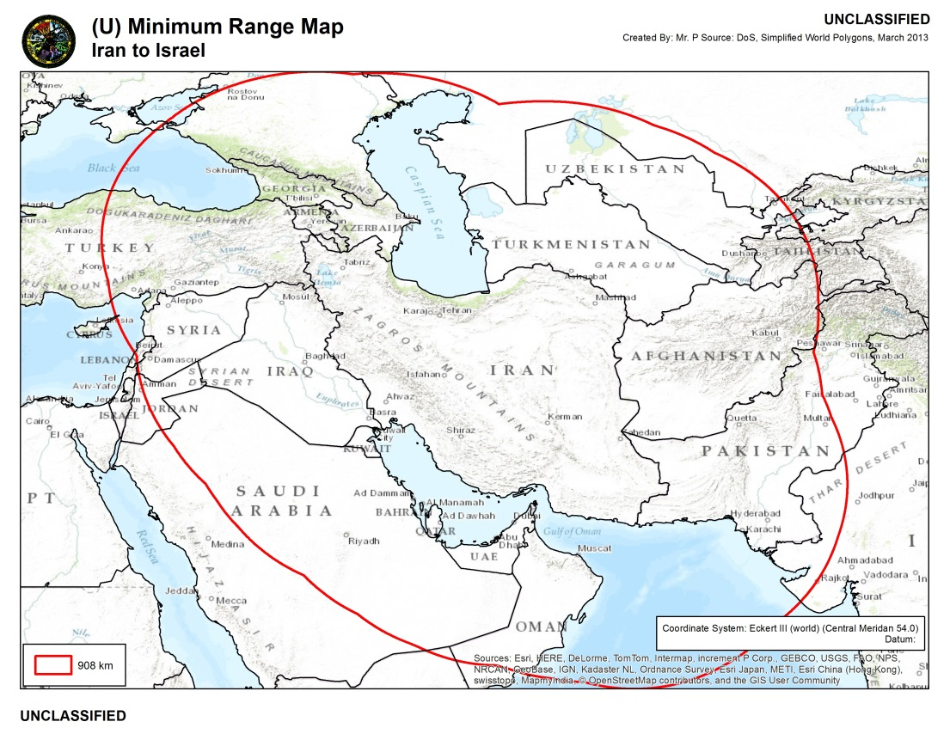
Minimum Range Ring Tool
Example of Minimum Range Ring Output from Israel to Iran
Calculate: 2 seconds
Generate Map: 40 seconds
Total: 42 seconds
(Alienware M11x Intel i7 CPU (quad core) U640 @ 1.20 GHz 4.00 GB RAM)

Slide 12
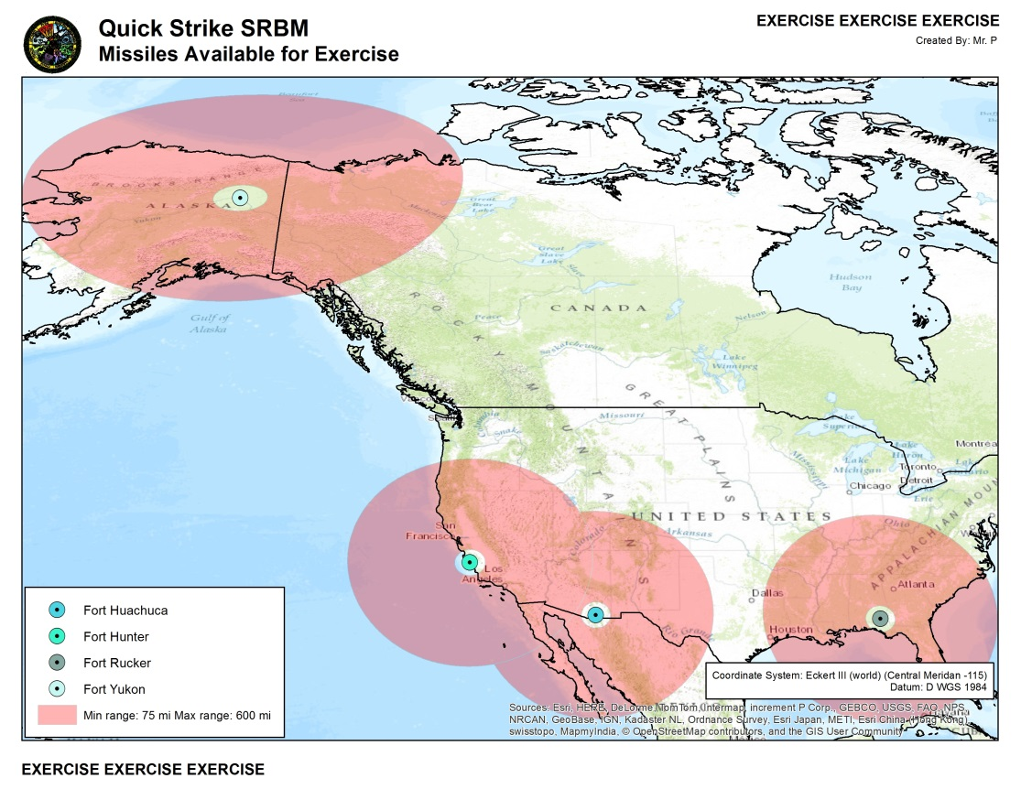
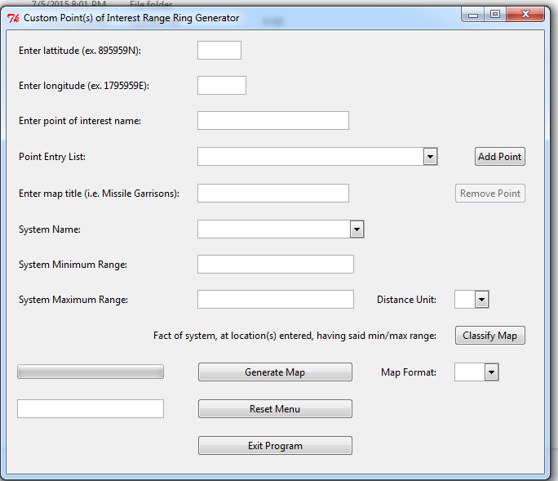
Custom Point of Interest(s) Range Ring Tool
Origin?
Example of range rings around custom points of interest (stored in point entry list dropbox)
Range rings = min/max range of a given system from a given point with each place given a different color dot.
Total: 24 seconds
(Alienware M11x Intel i7 CPU (quad core) U640 @ 1.20 GHz 4.00 GB RAM)

Slide 13
Backup

Slide 14
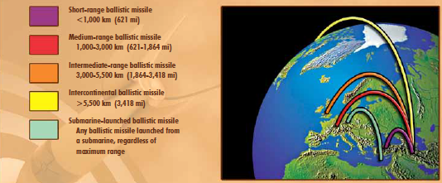
What are ballistic missiles?
Ballistic Missile Classifications
Source: NASIC, Ballistic and Cruise Missile Threat, 11 July 2013
Notes:
A traditional ballistic missile is a missile that, after the rocket motor burns out, travels along a ballistic flight path. These missiles are categorized as either an SRBM, MRBM, IRBM and ICBM with an additional class of SLBM that is meant for ballistic missiles launched from a submarine.
[Image] NASIC, Ballistic and Cruise Missile Threat (NASIC-1031-0985-13), 11 July 2013 pg. 9

Slide 15
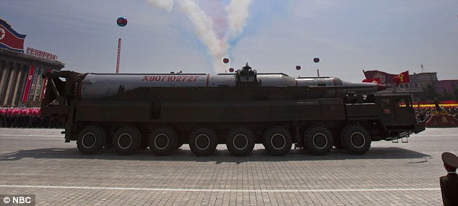

What are ballistic missiles?
Ballistic missiles are rocket-propelled vehicles that deliver nuclear or conventional payloads.
Potential uses of ballistic missiles can be for warfare and terrorism, and are an emerging threat to the global security environment.
Image Sources: Top Right: Blake, M. daily Mail, 16 August 2013; Bottom: Wminnick, Intercepts, 01 December 2012
Notes:
“Many countries view ballistic and cruise missile systems as cost-effective weapons and symbols of national power. In addition, they present an asymmetric threat to U.S. airpower (i.e. China’s CSS-5 Mod 5 (DF-21D) ASBM). Many ballistic missiles are armed with weapons of mass destruction.”[1][2][3]
[Top Left Image] Daily Mail, US Weapons Experts Claim North Korea’s Arsenal of Missiles That ‘Could Reach US’ are FAKE by Matt Blak, 16 August 2013
<http://www.dailystormer.com/us-weapons-experts-claim-north-koreas-arsenal-of-missiles-that-could-reach-us-are-fake/>
[Bottom Left Image] Intercepts, What China Wants for Christmas by wminnick, 01 December 2012
<http://intercepts.defensenews.com/2012/12/what-china-wants-for-christmas/>
Source:
[1] NASIC, Ballistic and Cruise Missile Threat (NASIC-1031-0985-13), 11 July 2013 pg. 3
[2] Andrew Erickson, Chinese ASBM Development: Drivers, Trajectories and Strategic Implicatons, [print] 18 September 2013
[3] Annual Report to Congress, Military and Security Developments Involving the People’s Republic of China 2015 (D-117FA69), 07 April 2015

Slide 16
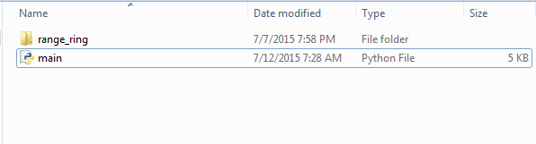
Accessing the GUI
Requirements
  ArcGIS 10.2.2 and above
  Python 2.7.9
GUI built by Python’s Tkinter and ttk module
  Other: arcpy, ctypes, imp, os, subprocess, sys, time
Double click main.py

Slide 17
Common Functions
Autocomplete
  Over 2,500 cities, 240 countries, 70 weapon systems
Customized projections
  Map centers on centroid of country or point(s)
Classification of product
  Automatically drawn from database
  Performed by user via classification tool
Output format (i.e. JPEG, PDF and KMZ)
  More output formats available for coding

Slide 18
Advantages
No GIS experience required
  ArcGIS is never opened only accessed via code
  Map document is accessible for advanced use
Relatively quick execution time
Different formats available
  Reduced time to output of additional formats
GUIs serve as templates for additional tools
Works for systems other than ballistic
  i.e. GLCM , ALCM , SAM , ATBM
  Code allows for the easy addition of more types

Slide 19
Limitations
Licensing
  Requires ArcGIS for Desktop Advanced
Customized projection sets needed
  Allow user to choose projection
    i.e. polar projection
  Adjust projection to center of process
    City, country or point of interest
Limit for range ring distance
  Function created to find maximum ranges compatible with ESRI due to processing error in Buffer Tool.

